Slide 1
Credit Card Customers Segmentation

Slide 2
Introduction
I created a model that estimates credit card customer segmentation to help the company to define its marketing strategy. I used the K-means algorithm with the K value determined by elbow method . I also used PCA for dimension reduction and better visualization.

Slide 3
TABLE OF CONTENTS
0
1
2
3
Look At The Big Picture
- Cluster- Unsupervised - Batch Learning - Model Based
Get The Data
- Importing the required libraries-Read The Data-Data Dictionary
Discover the Data
-Data Information-Describe the data - Data cleaning
Prepare the Data for ML Algorithm
remove the outliers- Imputing the missing data- Scale the Data

Slide 4
TABLE OF CONTENTS
4
5
6
3
Correlation
- Variables within a dataset can be related for lots of reasons.
PCA
- Principal Component Analysis
Cluster
- K-means - Visualization

Slide 5
Look At The Big Picture ( ) Customers Segmentation
problem? Cluster Type of machine learning system? Supervised / Unsupervised Batch Learning / Online Learning Instance Based / Model Based

Slide 6
1
Get The Data

Slide 7
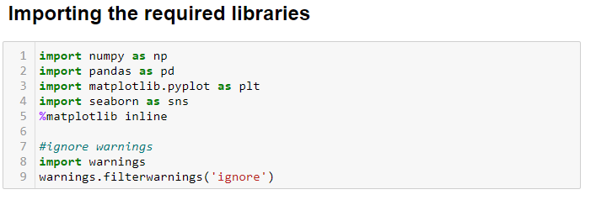
Importing the required libraries

Slide 8
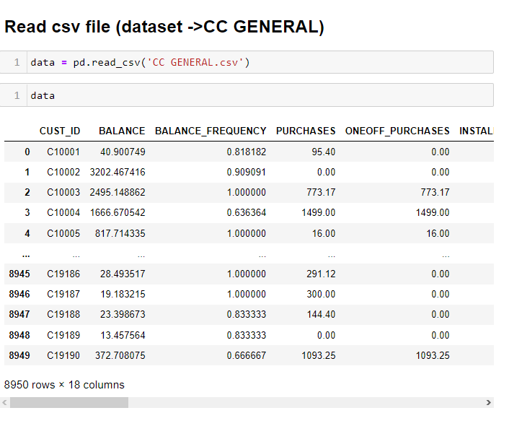
Read The Data
Data Dictionary
This case requires to develop a customer segmentation to define marketing strategy. The sample Dataset summarizes the usage behavior of about 9000 active credit card holders during the last 6 months. The file is at a customer level with 18 behavioral variables.

Slide 9
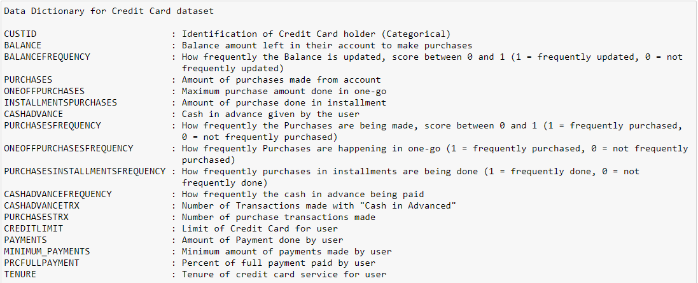
Data Dictionary
To understand better about each feature of the data means,

Slide 10
2
Discover the Data

Slide 11
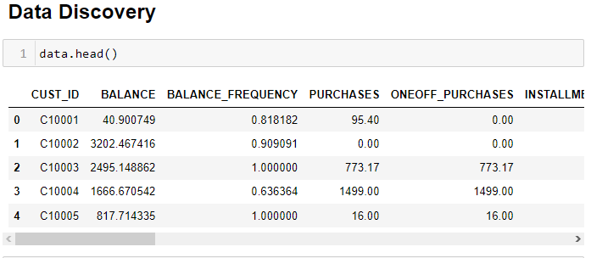
Data Discovery

Slide 12
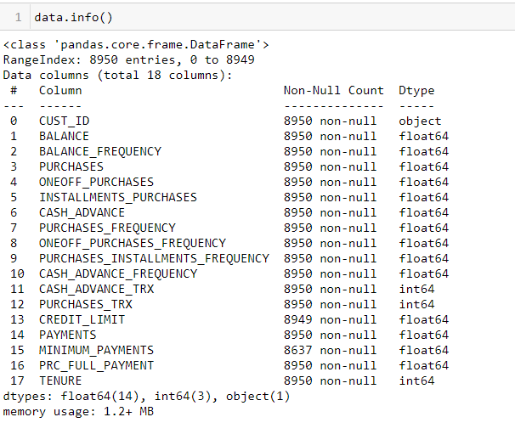
Data Discovery
We observed that we have null values in MINIMUM_PAYMENTS and CREDIT_LIMIT .
We have just the CUST_ID object and The rest is digital so we will drop it..

Slide 13
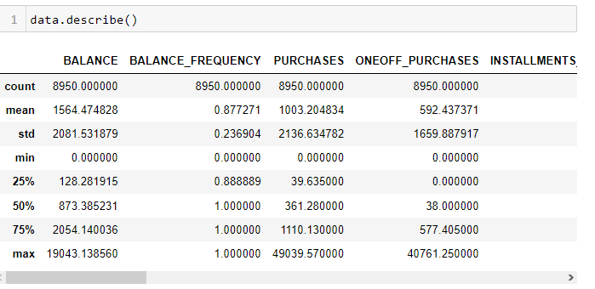
Data Discovery
determine the statics for columns
Observations:
The value ranges vary among fields, hence scaling is required.

Slide 14
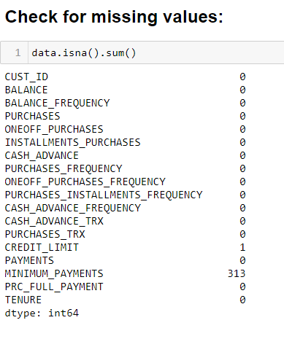
Data Discovery
Missing value
Observations:
we have 313 null values in
MINIMUM_PAYMENTS
we have 1 null value in CREDIT_LIMIT

Slide 15
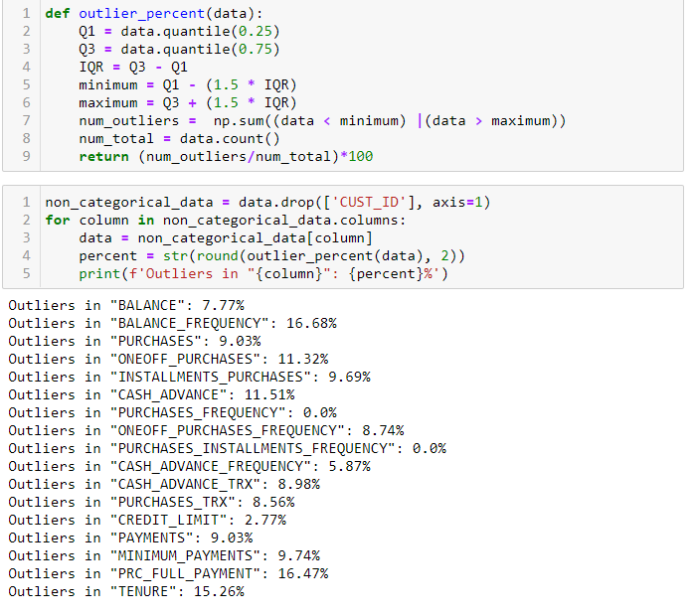
Data Discovery
We have outliers in each features except PURCHASES_INSTALLMENTS_FREQUENCY and PURCHASES_FREQUENCY

Slide 16
3
Prepare the Data for ML Algorithms

Slide 17
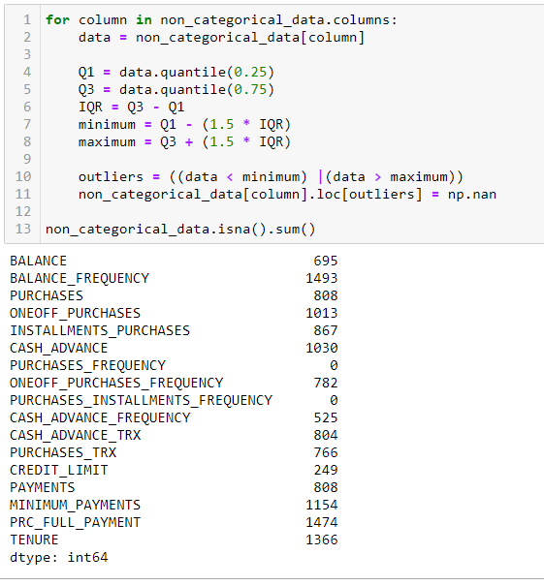
Preprocessing
remove the outliers
We're going to first set all outliers as NaN, so it will be taken care of in the next step, where we impute the missing values.

Slide 18
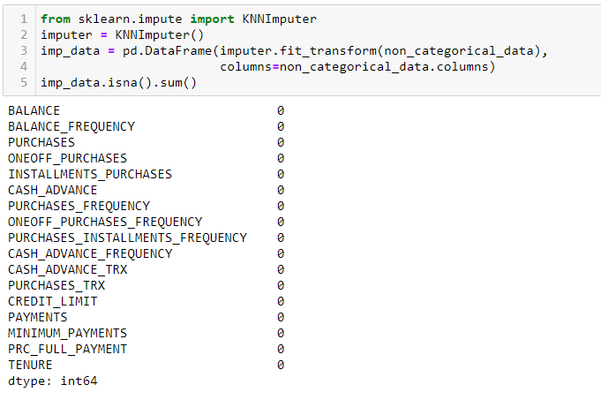
Preprocessing Imputing the missing data
K-Nearest Neighbor Imputation
KNN imputer: Each sample’s missing values are imputed using the mean value from n-neighbors nearest neighbors found in the training set.

Slide 19
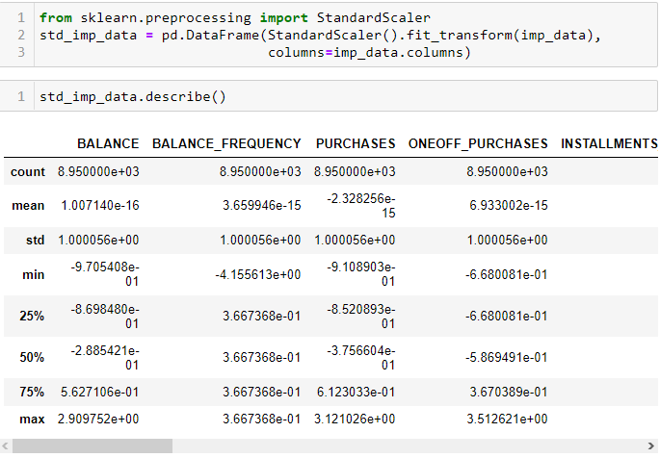
Preprocessing Scale the Data
Normalization is a technique often applied as part of data preparation for machine learning. The goal of normalization is to change the values of numeric columns in the dataset to a common scale, without distorting differences in the ranges of values. For machine learning, every dataset does not require normalization. It is required only when features have different ranges.

Slide 20
4
Correlation

Slide 21
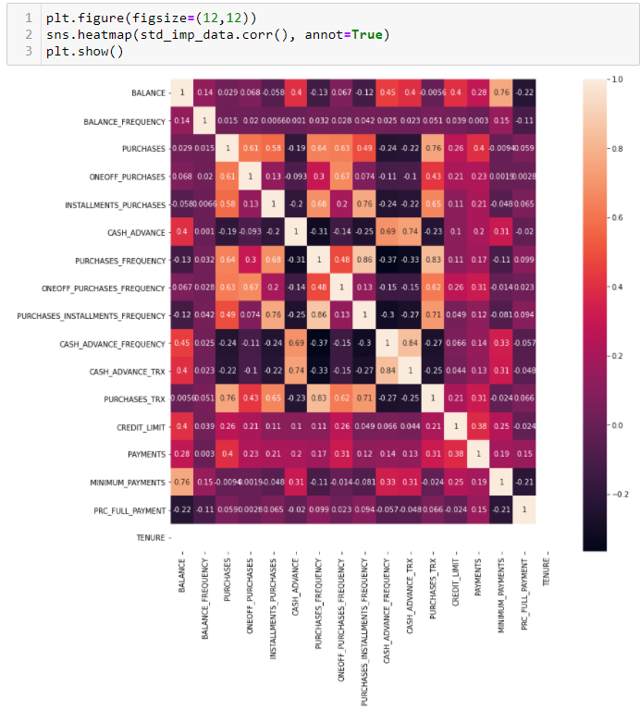
Correlation
We've got some correlated features there We will use PCA for our dimensionality reduction

Slide 22
5
PCA

Slide 23
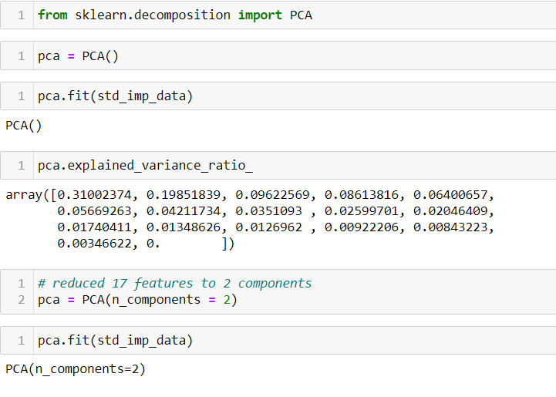
Dimension Reduction using PCA
Principal Component Analysis (PCA) to transform data into 2 dimensions for visualization because we won’t be able to visualize the data in 17 dimensions. PCA transforms a large set of variables into a smaller one that still contains most of the information in the large set. Reducing the number of variables of data.

Slide 24
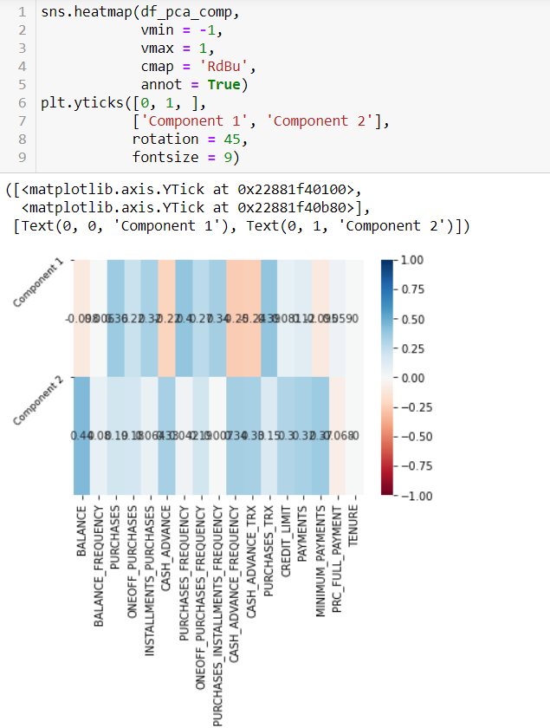
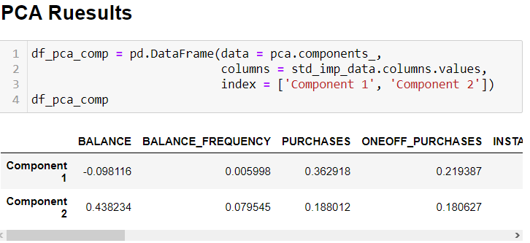
PCA Results

Slide 25
6
Cluster

Slide 26
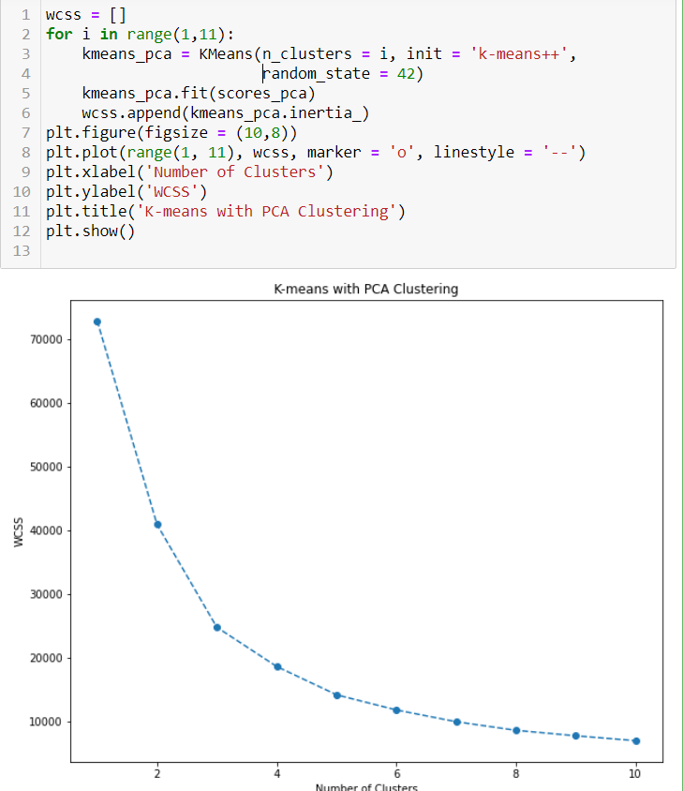
Clustering K-means
We must first specify the number of clusters K. Here I used the elbow method to specify the best K. Elbow is a very simple method that gives us plots like elbow shape. And we can easily guess the optimal number of K from the plot.

Slide 27
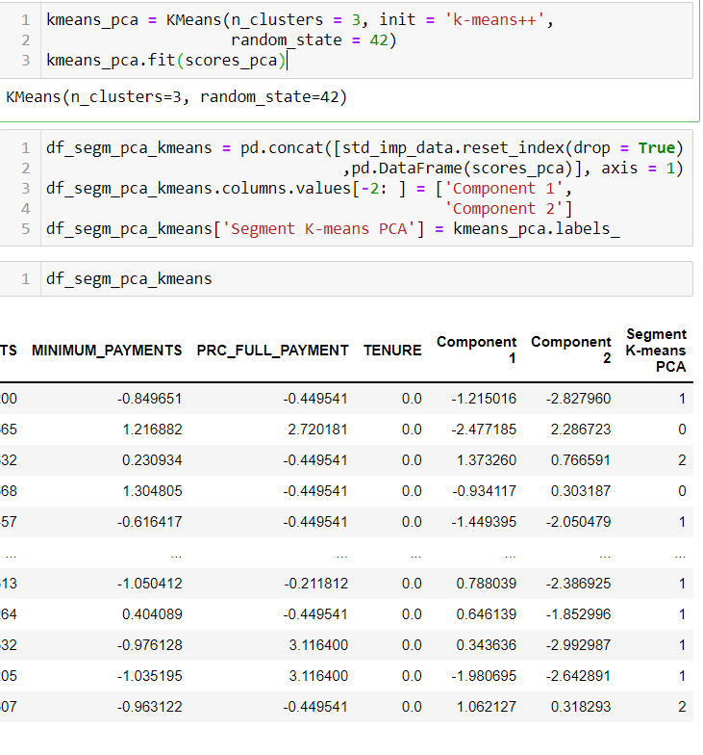
Clustering K-means
K-means
algorithm is an iterative algorithm that tries to partition the dataset into K pre-defined distinct non-overlapping subgroups (clusters) where each data point belongs to only one group.

Slide 28
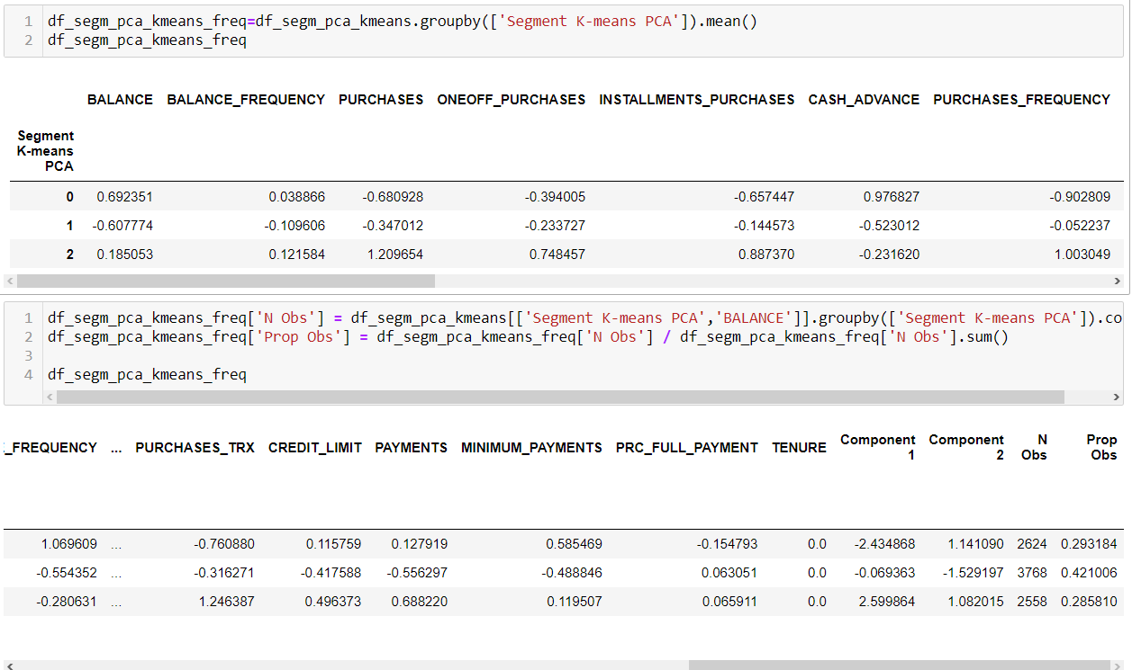
N Obs and Prop Obs

Slide 29
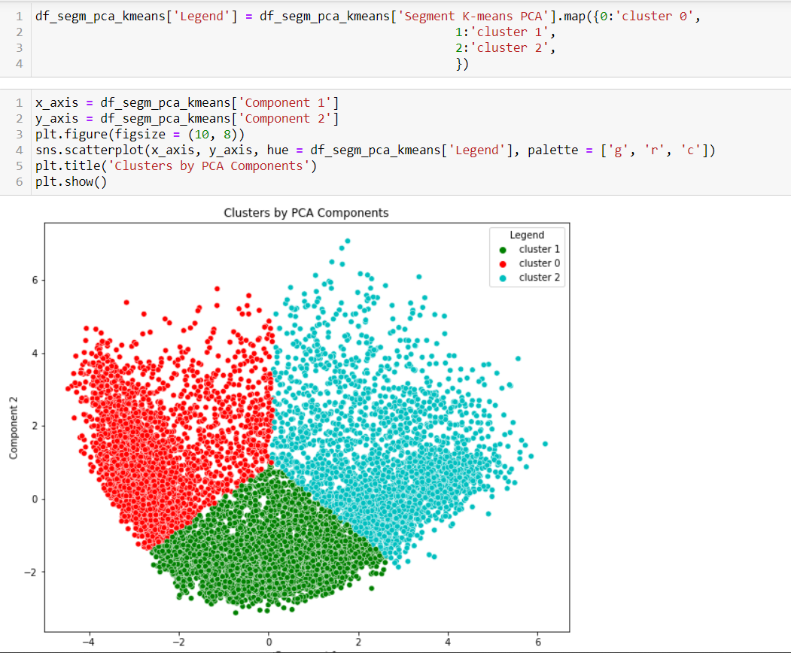
Cluster Visualization

Slide 30
The End
Rama Al Marhlh

Slide 31
THANKS!

